Slide 1
Image2Code
5/Jun/2019

Slide 2
Contents
What is this?
Problem Statement
Progress
Current Results

Slide 3


What is this?
User Scenario 1
Let’s make a FANCY website!!!
Why not? You aren’t the one who writes code
John – Designer
Know nothing about coding
Bob – Web Developer
Care about nothing except coding

Slide 4
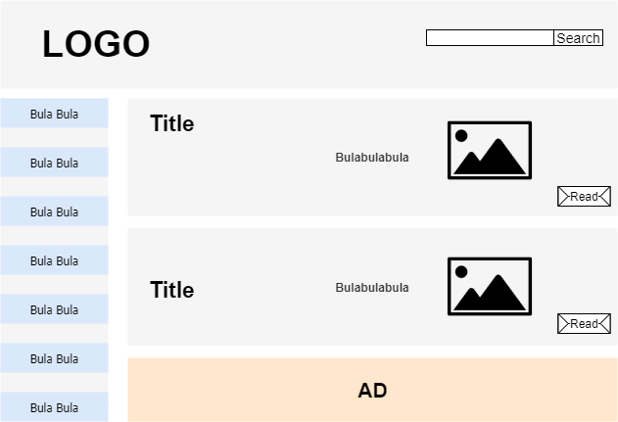
What is this?
User Scenario 1
This is my genius design !!!
John – Designer
Know nothing about coding
Image Prototype

Slide 5
What is this?
User Scenario 1
Okay, I will spend four days to transform this into code
Bob – Web Developer
Care about nothing except coding
Image Prototype

Slide 6
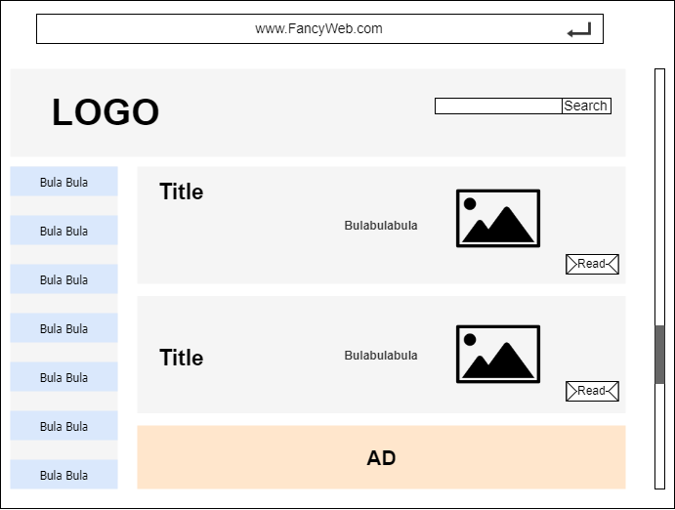

What is this?
User Scenario 1
OR, I can take several SECONDS to do so by using the
IMG2CODE
Bob – Web Developer
Care about nothing except coding
Working Static Webpage

Slide 7
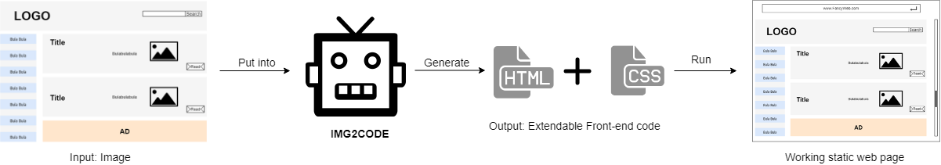
What is this?
User Scenario 1: Image Design to Code

Slide 8
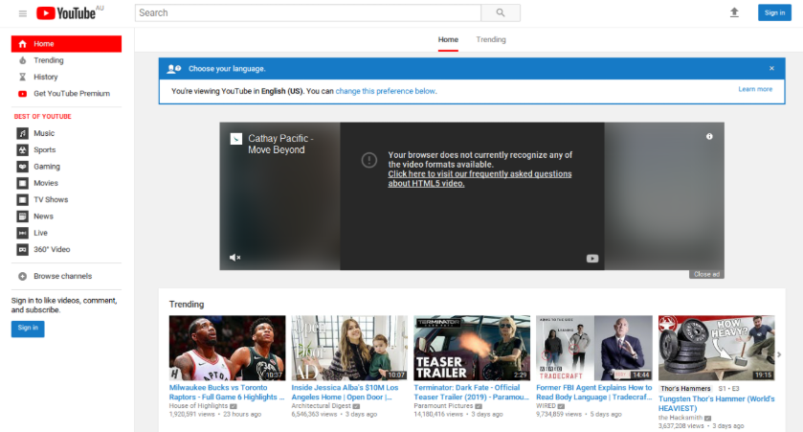
What is this?
User Scenario 2
Let me check Youtube
I want to develop a video website, but I don’t have any clue
Bob – Web Developer
Care about nothing except coding

Slide 9
What is this?
User Scenario 2
This is what I want !!!
It would be perfect if I can have the similar design style !!!
Bob – Web Developer
Care about nothing except coding

Slide 10
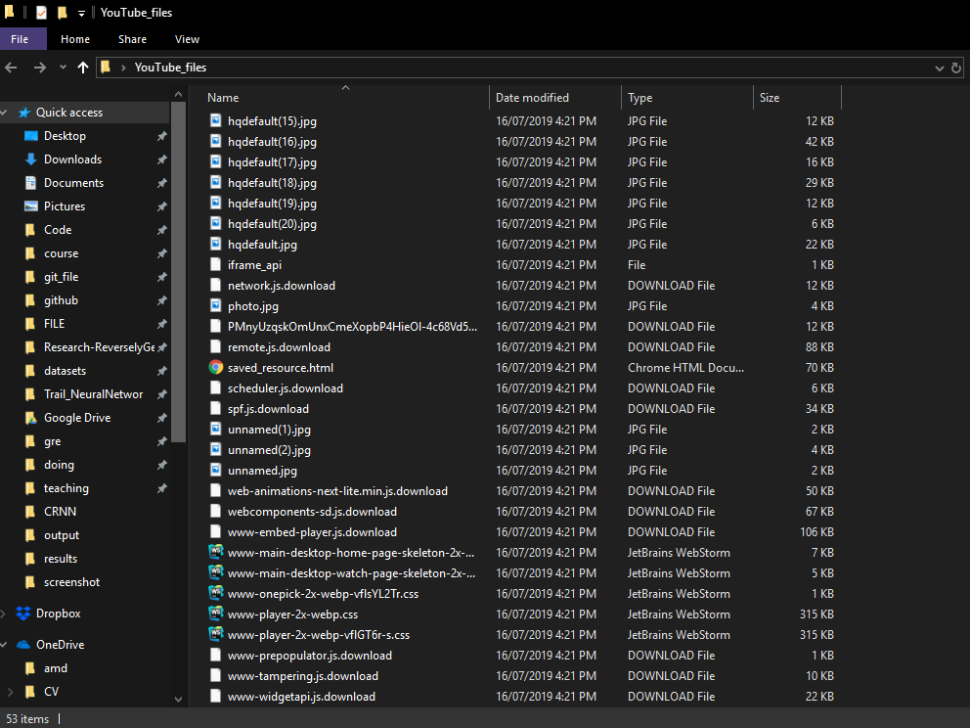

What is this?
User Scenario 2
Conventional Way to Reuse UI
Download the Source Code

Slide 11
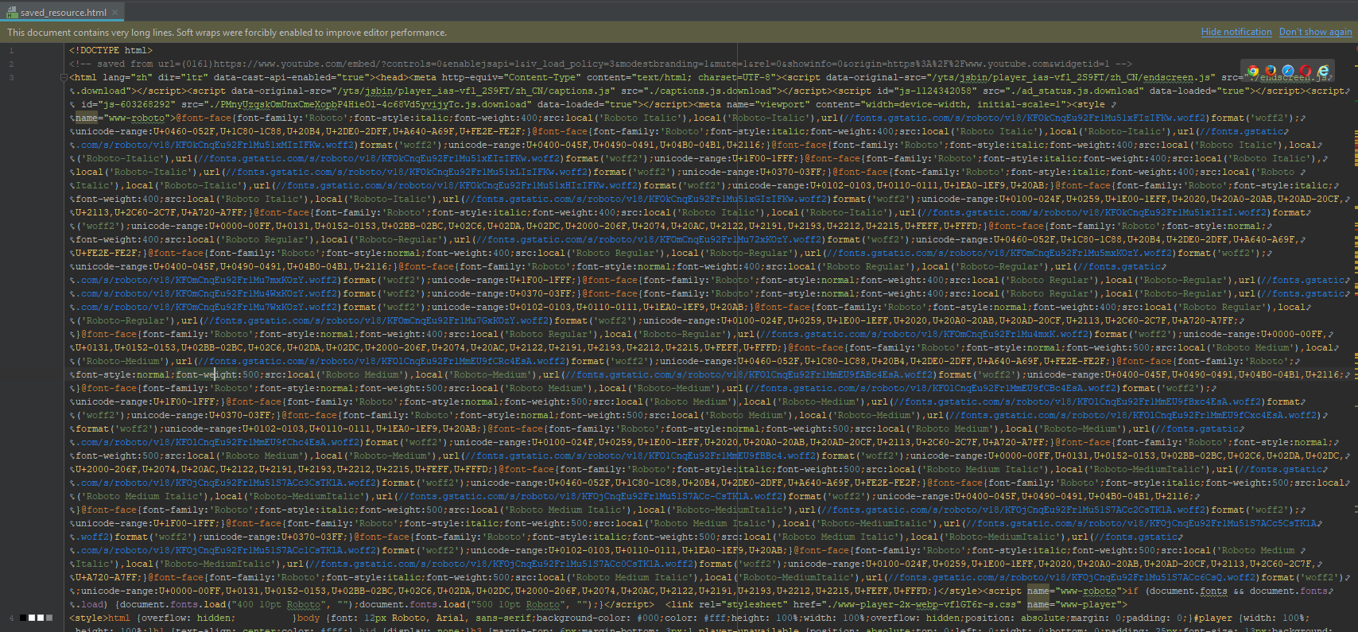
What is this?
User Scenario 2
Conventional Way to Reuse UI
Analyze the Compressed Code

Slide 12
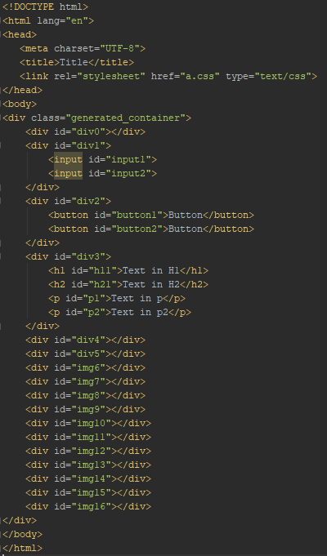
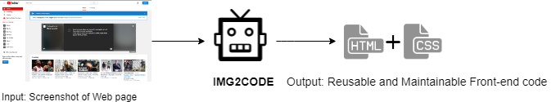
What is this?
User Scenario 2: Screenshot to Code – UI Reuse

Slide 13

Problem Statement
Final Goal
Generate the front-end CODE from any given web page IMAGE

Slide 14
Problem Statement
Final Goal
Generate the front-end CODE from any given web page IMAGE
Sub Goals
1. Detect and classify UI components (Button, Text, Image) on the input image
2. Reversely generate usable front-end code (HTML, CSS)

Slide 15
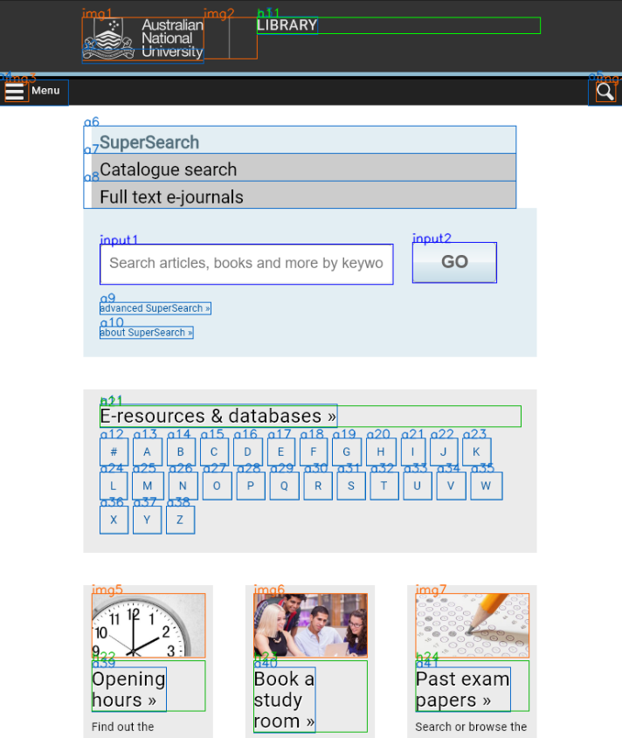
Problem Statement
UI Components Detection and Classification
Tricky problem: Efficient detection of simple UI components

Slide 16

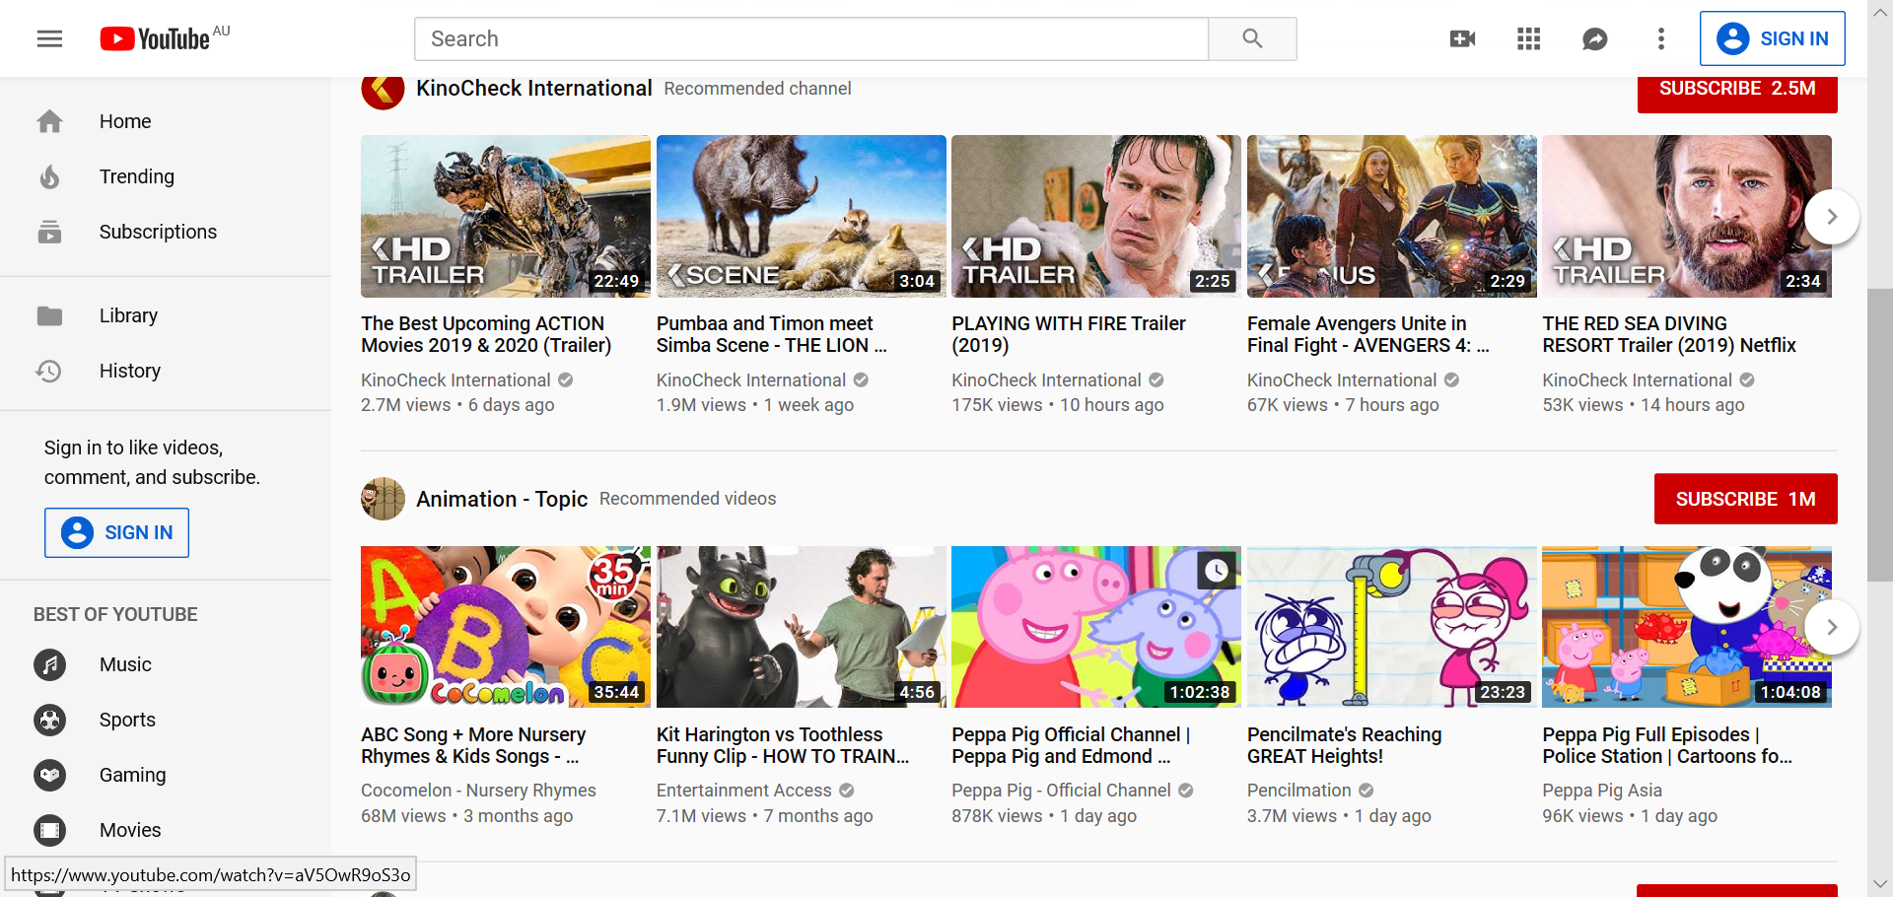
Problem Statement
UI Components Detection and Classification
Tricky problem: Misrecognize contents of the <img> as the web components.

Slide 17
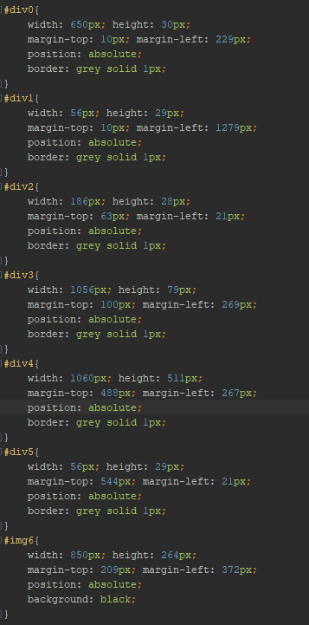
Problem Statement
Maintainable Code Generating
Tricky problem: Make generated code easy to edit and extend.

Slide 18
Progress
Attempts on UI Components Detection and Classification
1. End-to-End: Deep Learning
Objection detection method
2. Divide and Conquer: Image Processing + Machine Learning
Decompose elements and Classify them

Slide 19
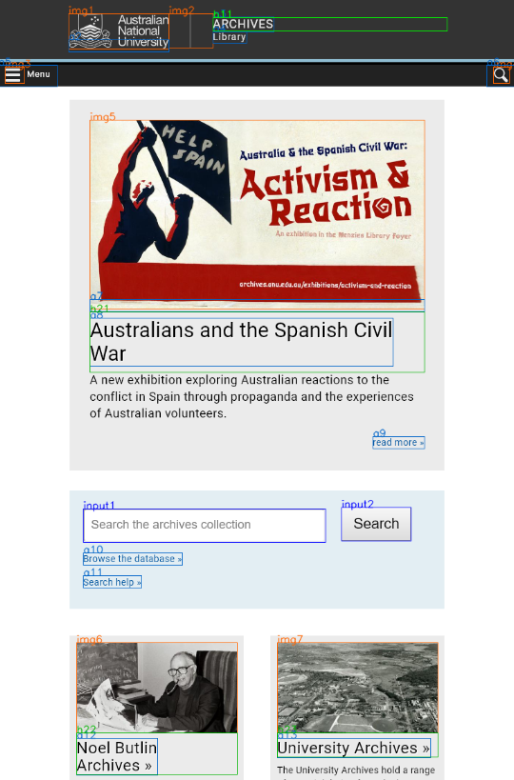
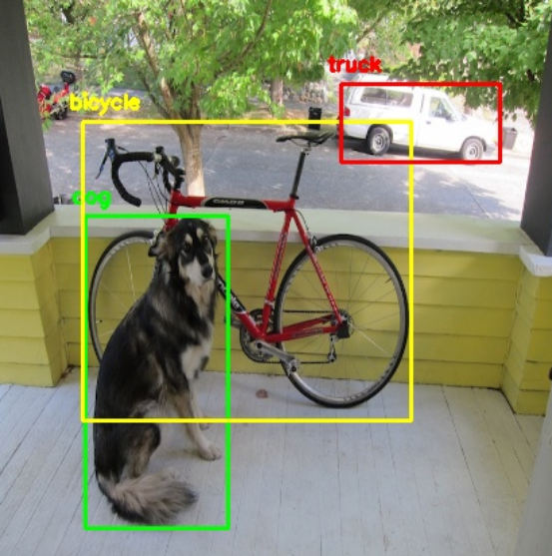
Progress
End-to-End (Deep Learning)
Refer to the Objection Detection Method

Slide 20

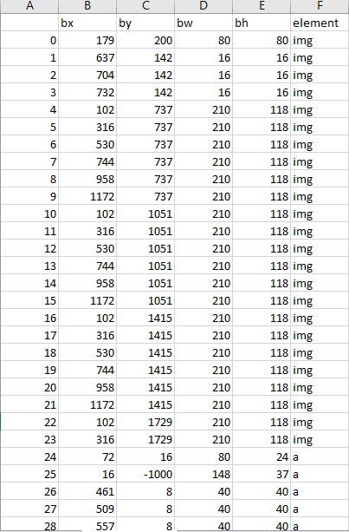
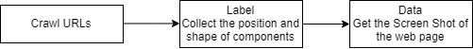
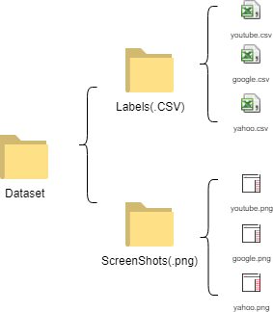
Progress
End-to-End (Deep Learning)
Dataset Collection

Slide 21
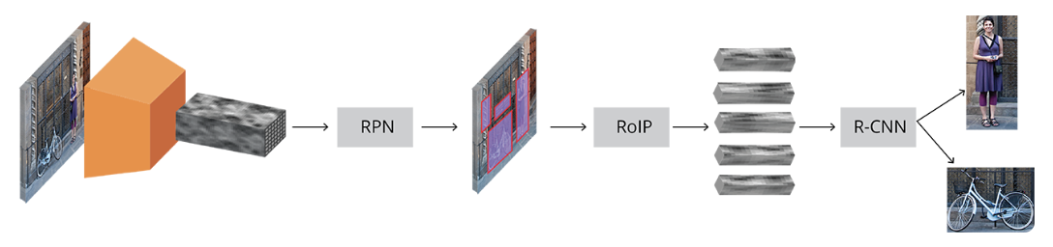
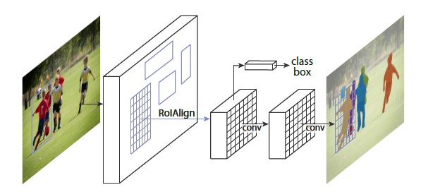
Progress
End-to-End (Deep Learning)
Model Selection
1. YOLO v3
2. Faster RCNN
3. Mask RCNN
Faster RCNN
Mask RCNN

Slide 22
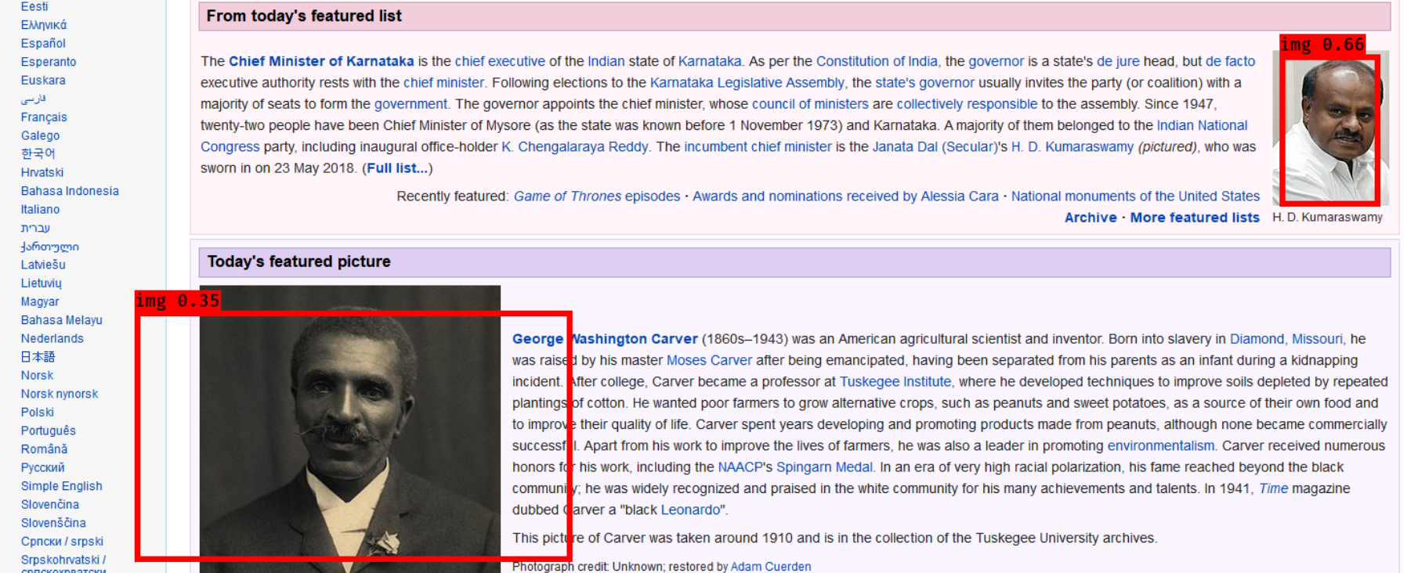
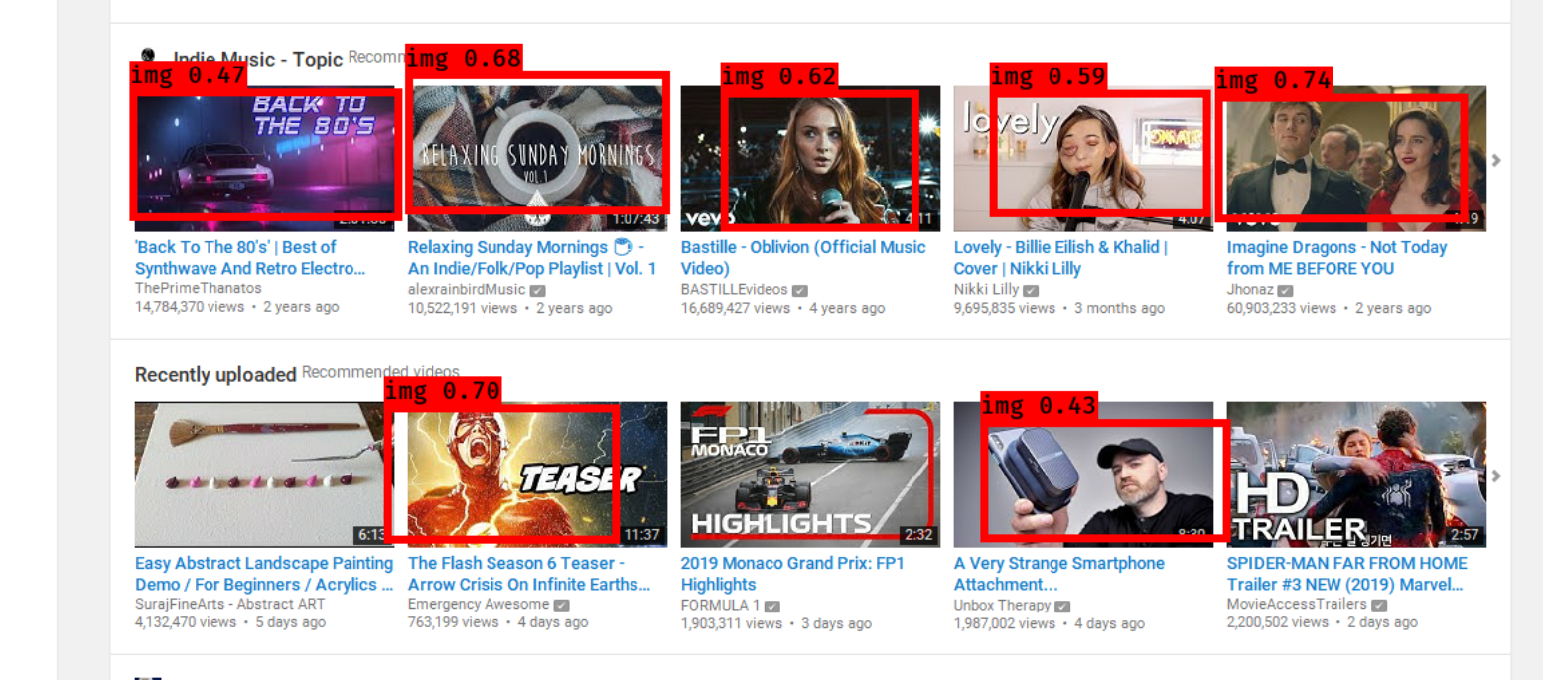
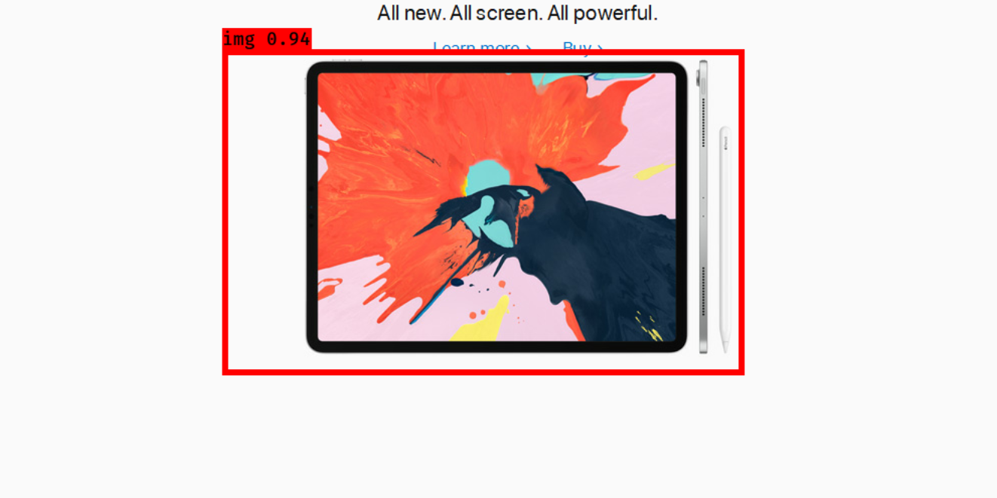
Progress
End-to-End (Deep Learning)
Experiment:
YOLOv3 + VGG16 (Base Net)
Trained on 1200 Images

Slide 23
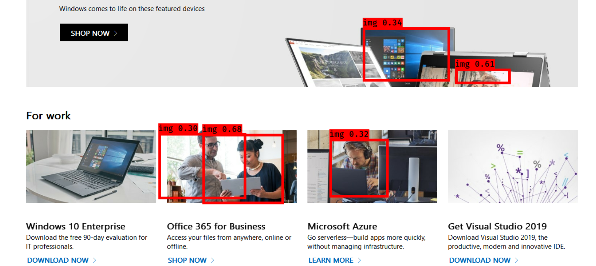
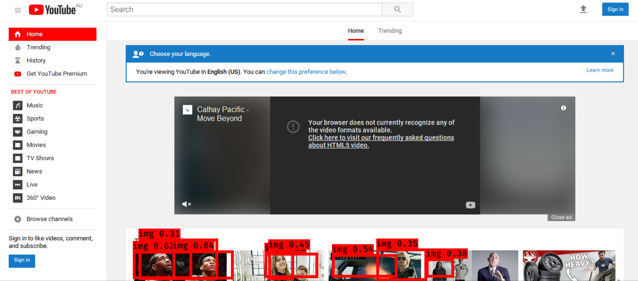
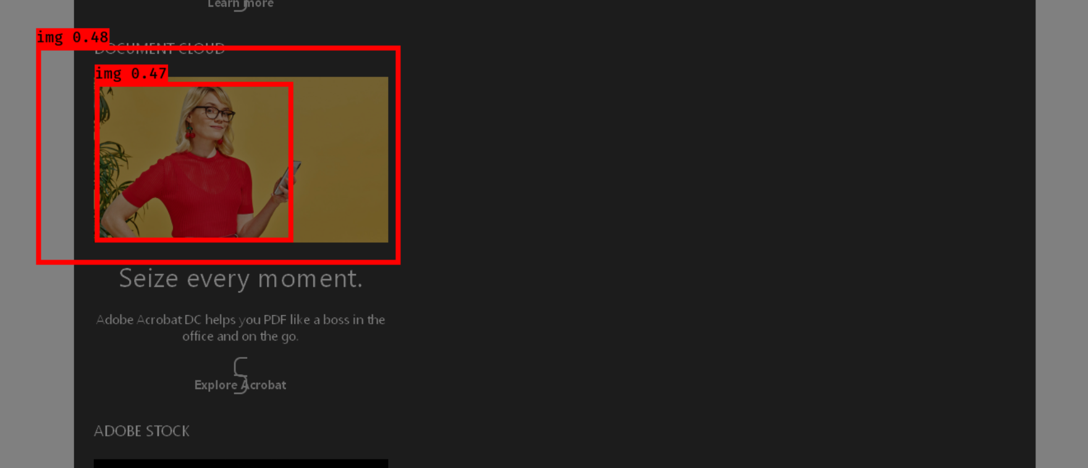
Progress
End-to-End (Deep Learning)
Experiment:
YOLOv3 + VGG16 (Base Net)
Trained on 1200 Images

Slide 24
Progress
End-to-End (Deep Learning)
Issues:
1. Hard to predict the accurate position of elements
2. Susceptible to the complex image elements on the screenshot

Slide 25
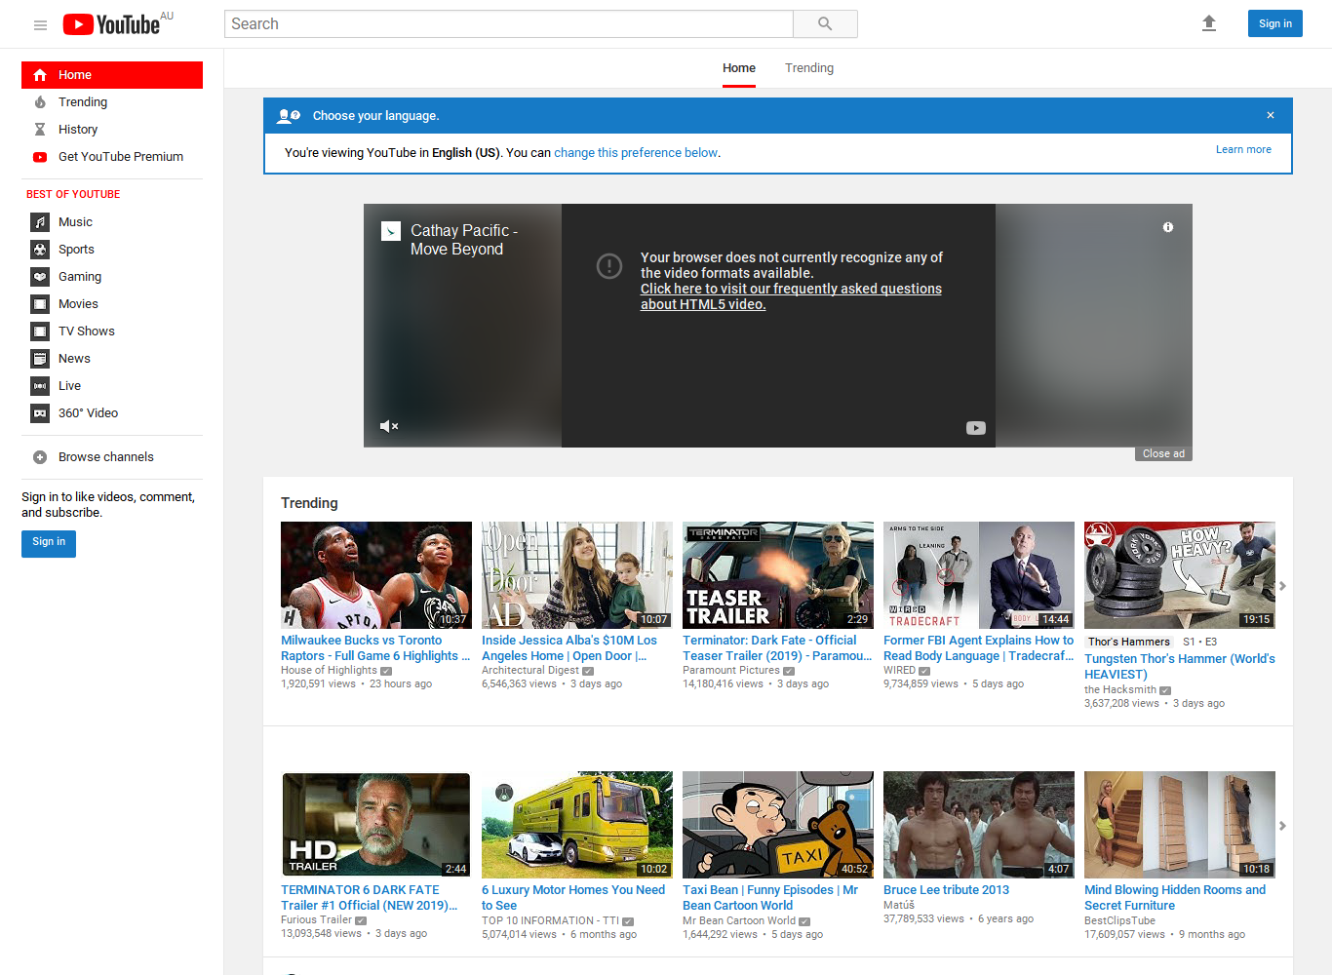
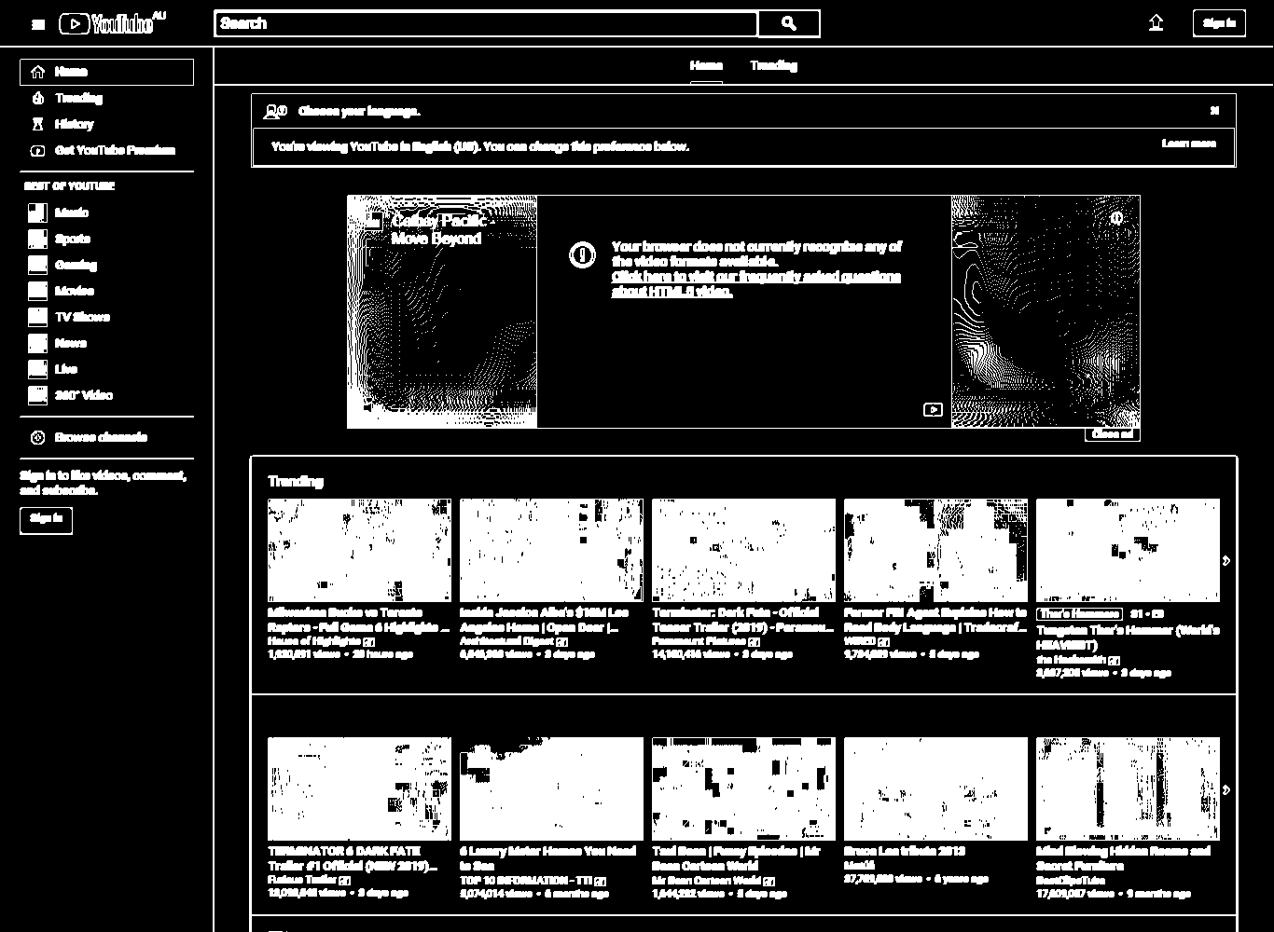
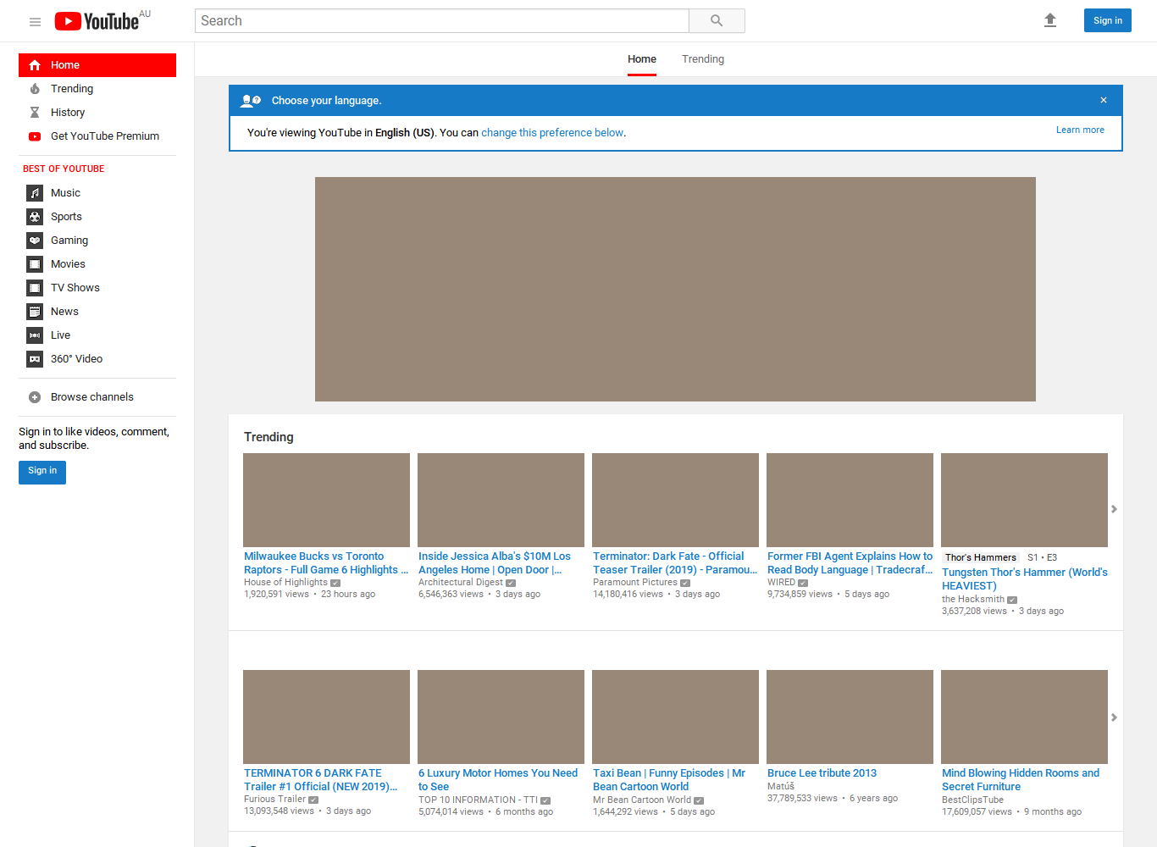
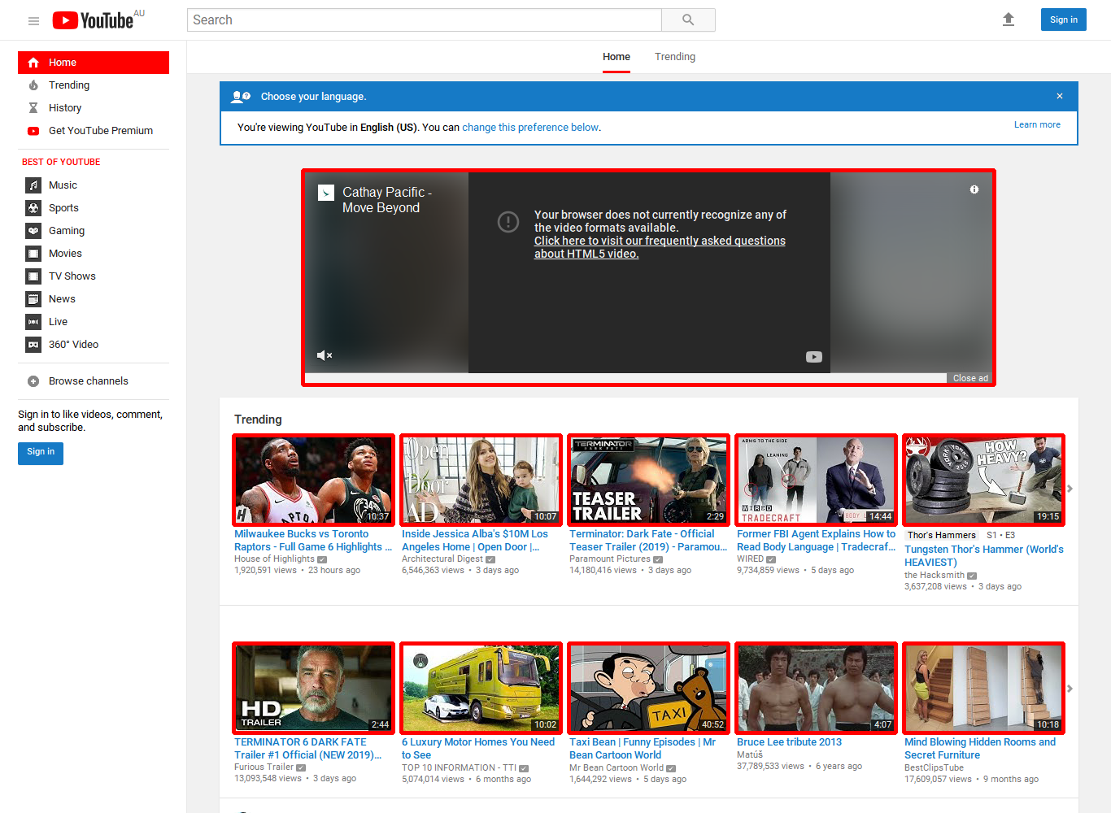
Progress
Divide and Conquer (Computer Vision)
Process:
1. Detect and Separate the <image> components on the screenshot first
2. Classify the other UI components

Slide 26
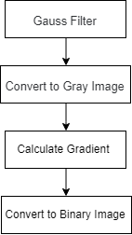
Progress
Divide and Conquer (Computer Vision)
<Img> Detection:
Original Image Processing Algorithms
Pre-processing

Slide 27
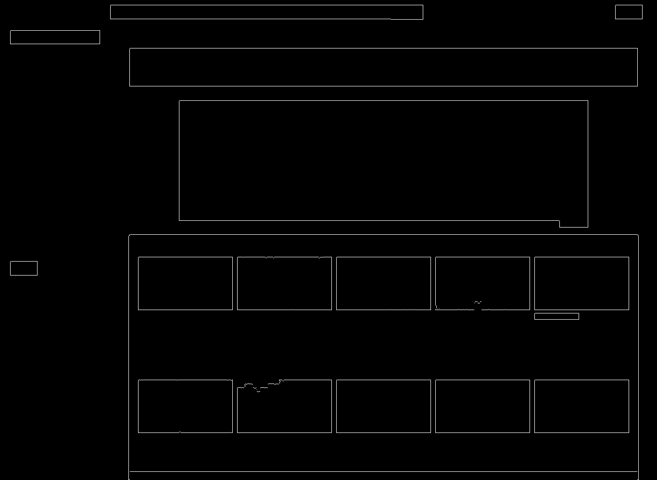
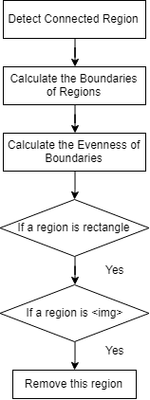
Progress
Divide and Conquer (Computer Vision)
<Img> Detection:
Original Image Processing Algorithms
Region processing

Slide 28
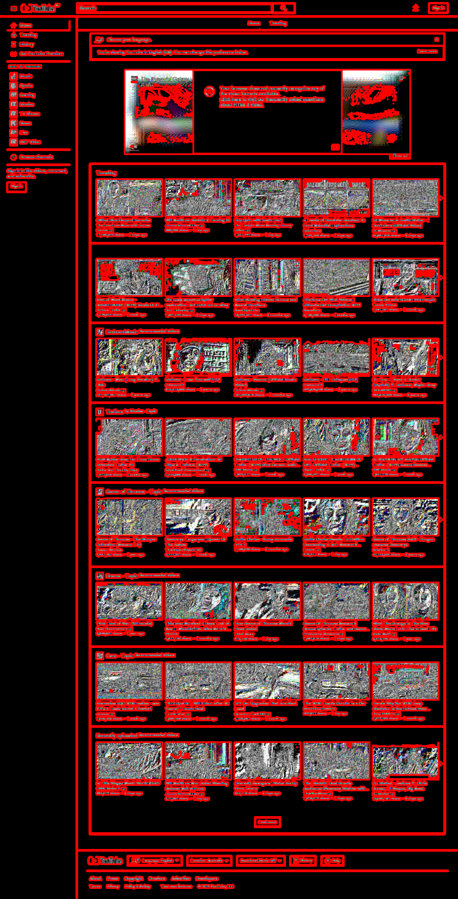
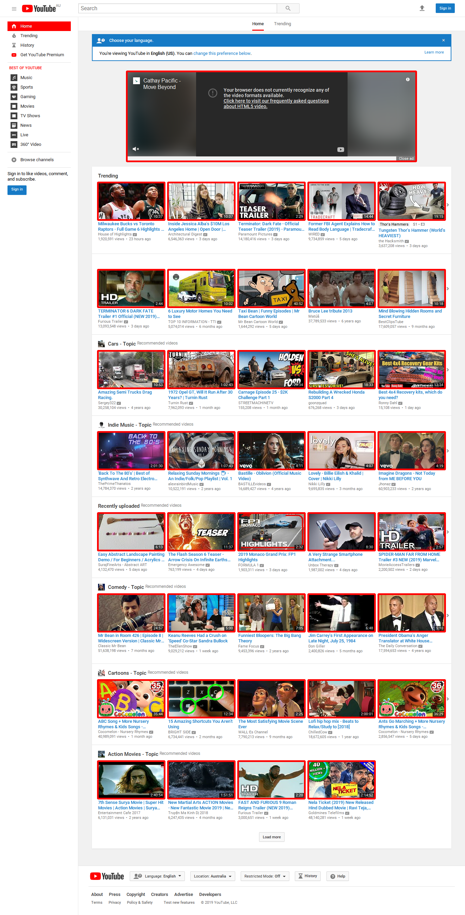
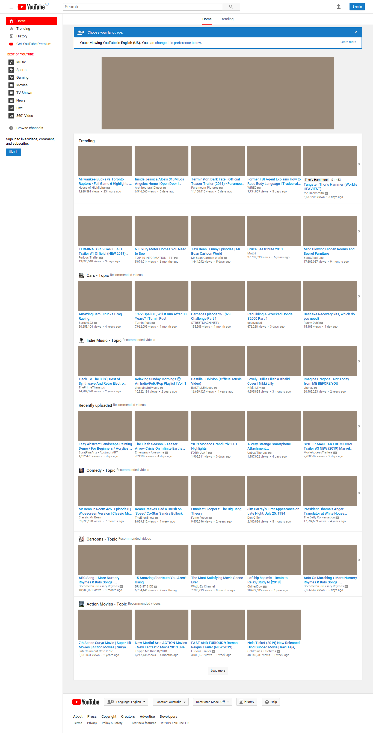
Progress
Divide and Conquer (Computer Vision)
<Img> Detection:
Original Image Processing Algorithms

Slide 29
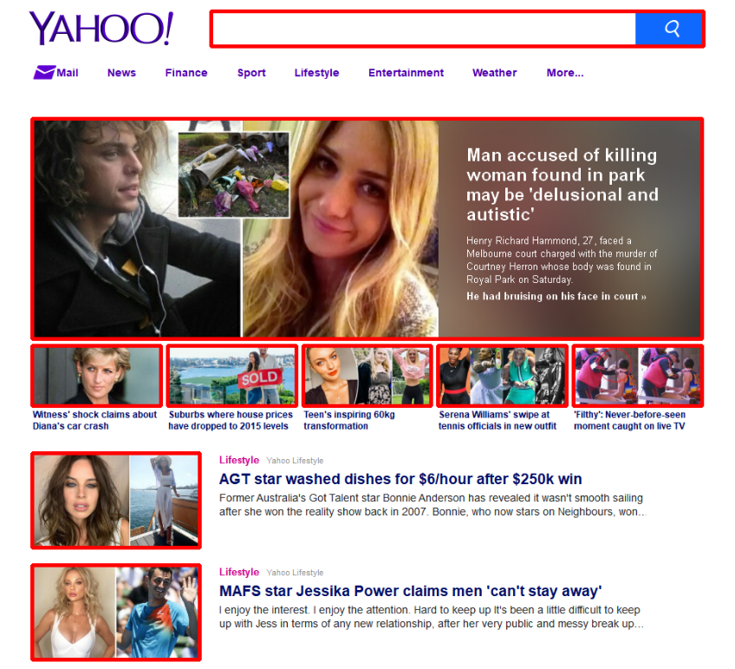
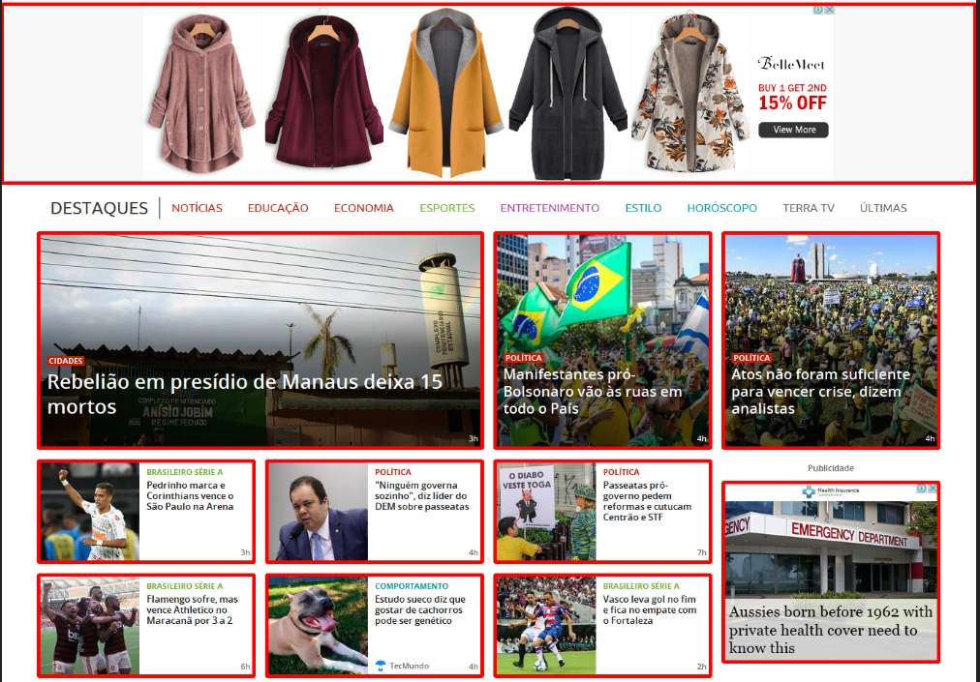
Results
Image Detection

Slide 30
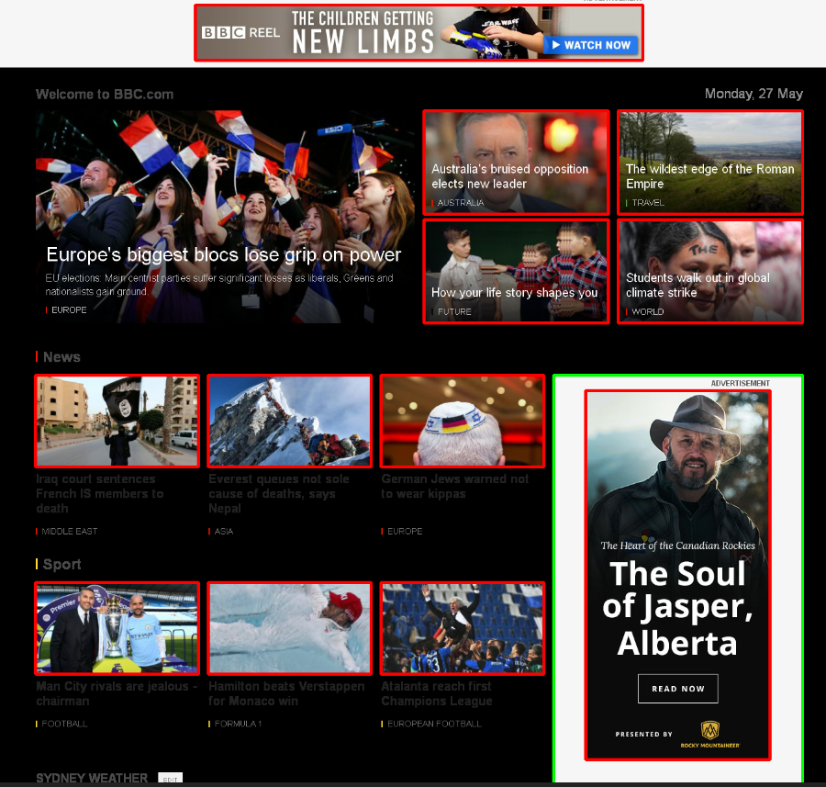
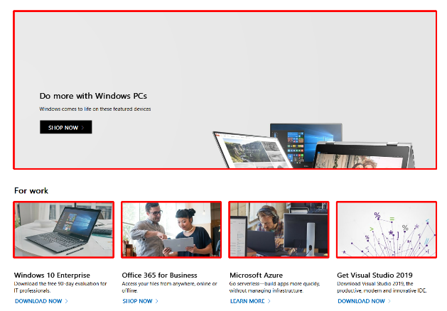
Results
Image Detection

Slide 31
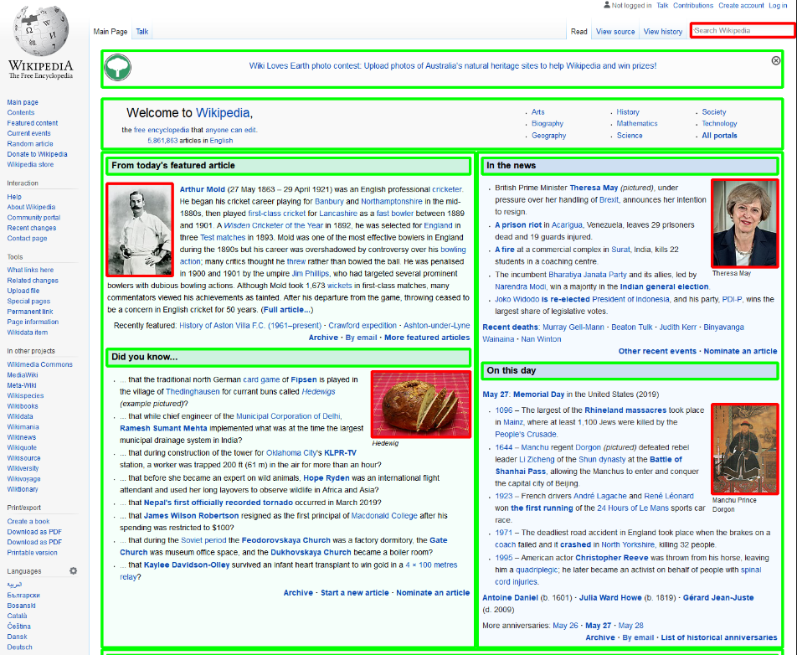
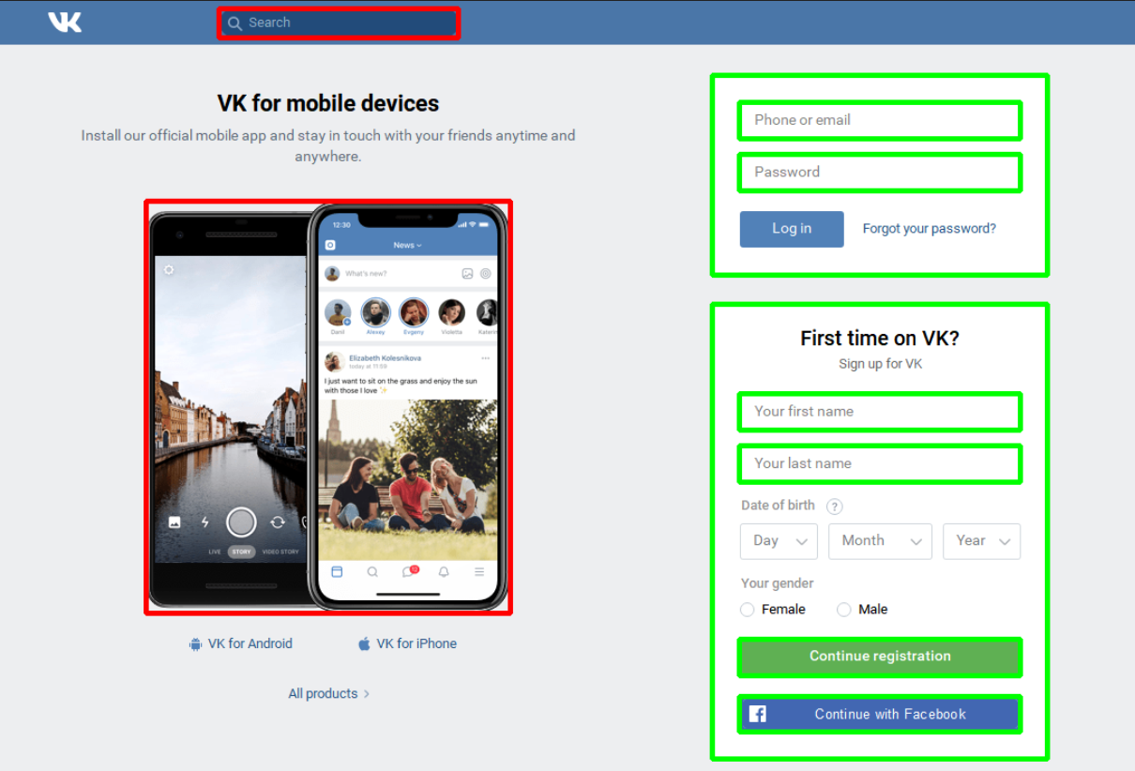
Results
Image Detection

Slide 32
Results
Code Generation

Slide 33
Future Work
Image Processing
Simple UI components detection and classification (Object Detection)
Text detection (OCR)
Code Generation
Extendable and maintainable code
Fit to real developer’s usual practice

